Slide 1
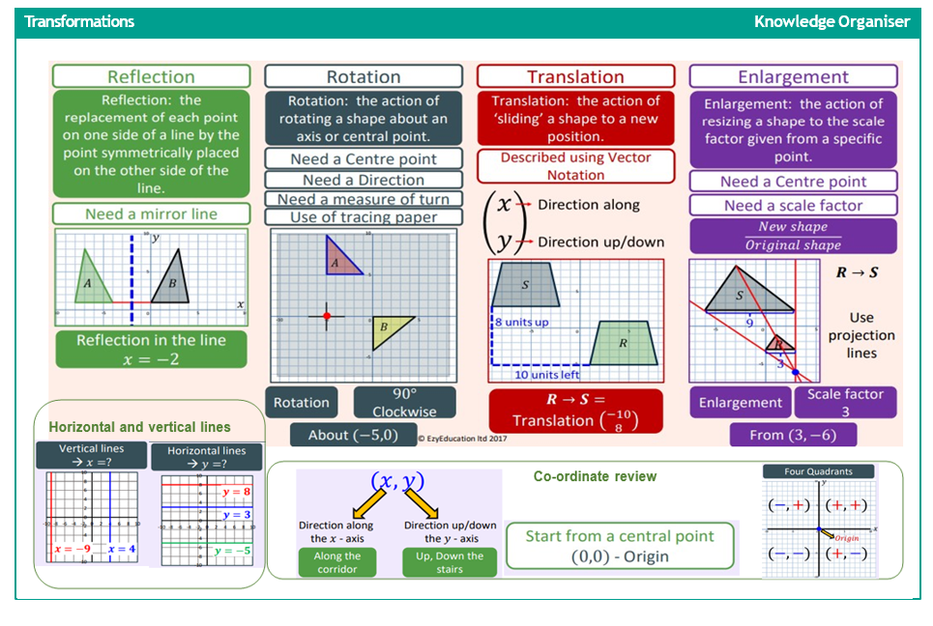
Maths
Transformations

Slide 2
Venn diagrams

