Slide 1
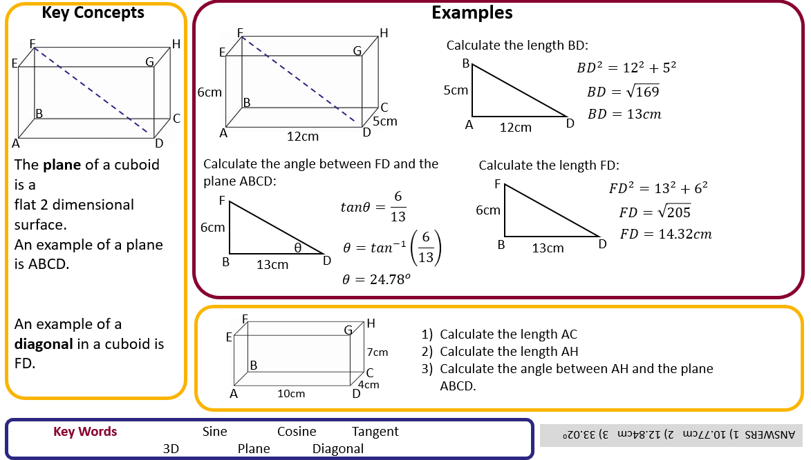
Maths – Y10H. Spring 2
Pythagoras
Transformations

Slide 2
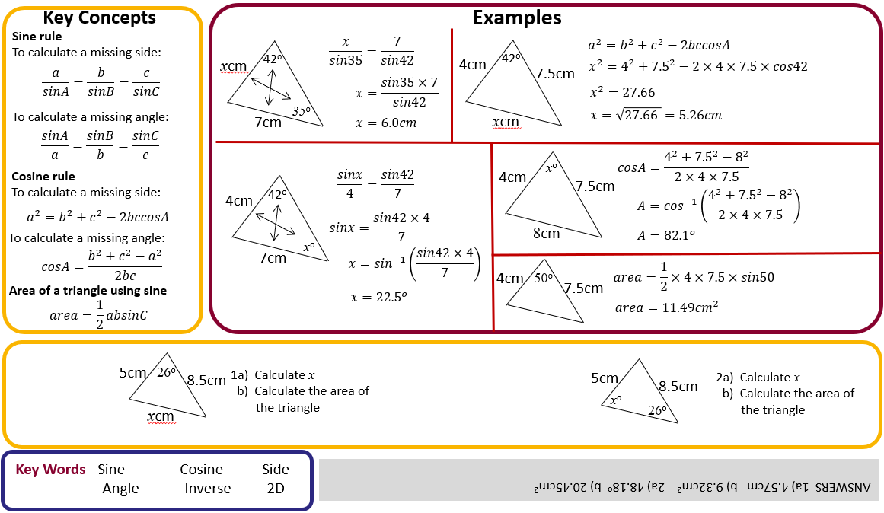
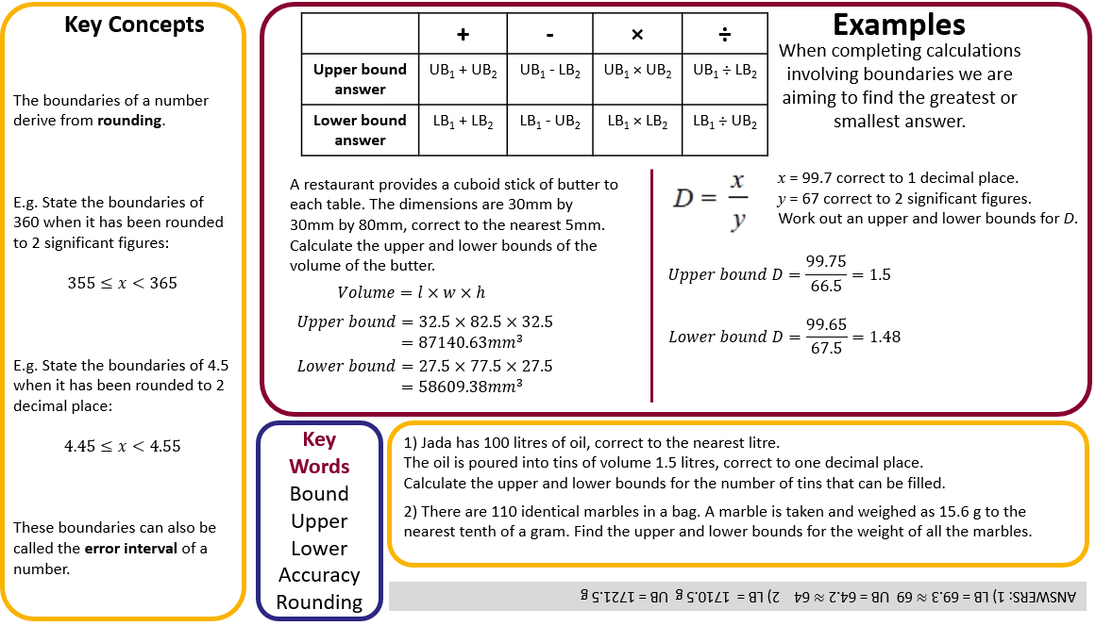
Maths – Y10H. Spring 2
Further Trigonometry
Bounds

