Slide 1
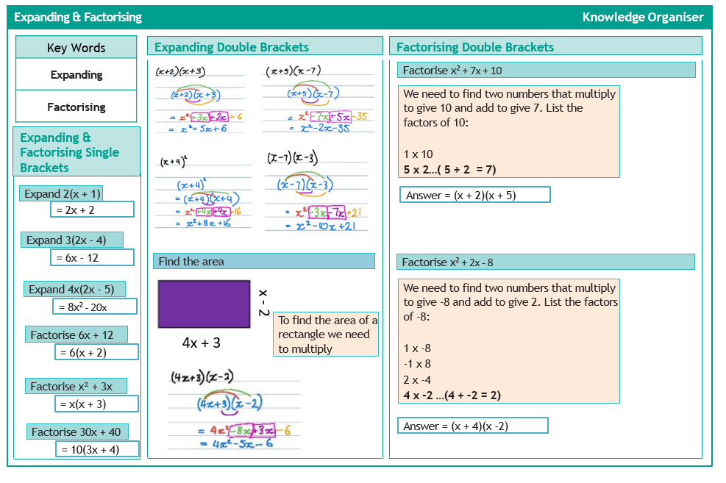
Expanding & Factorising

Slide 2
Ratio

Slide 3
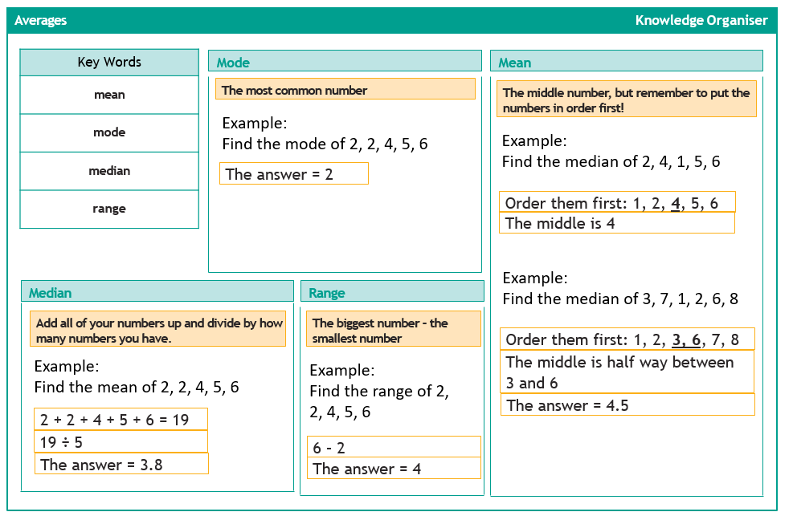
Averages

