Slide 1

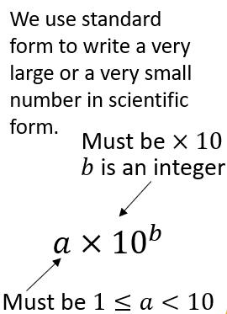
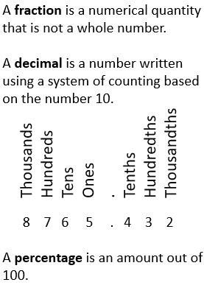
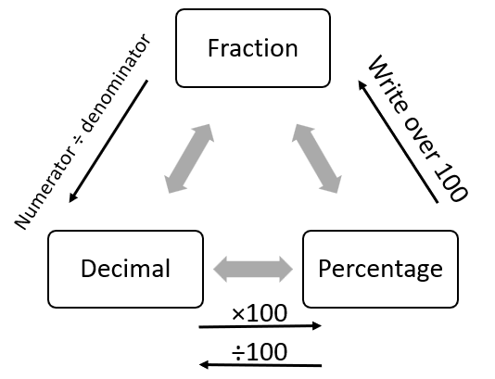

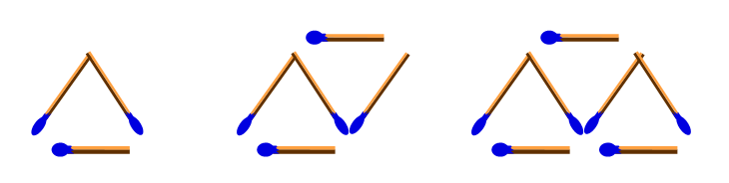

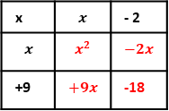
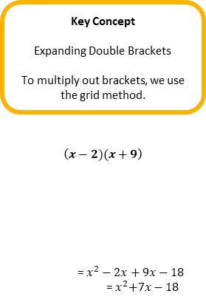



Maths
Year 8 Number
Key Concept
Standard Form
Examples
Write the following in standard form:
3000 = $3×{10}^{3}$
4580000 = $4.58×{10}^{6}$
0.0006 = $6×{10}^{−4}$
0.00845 = $8.45×{10}^{−3}$
Key Concept
Rounding
Digits are the individual components of a number.
Integers are whole numbers.
Rounding rules:
A value of 5 to 9 rounds the number up.
A value of 0 to 4 keeps the number the same.
Key Words
Estimate: Round each value to 1 significant figure, then complete the calculation using the rounded values.
Multiplier: A percentage wrote as a decimal, which can then be multiplied by an amount.
Integer: A whole number, a number with no decimal or parts of.
Key Concept
FDP
Key Concept
Percentages
Calculating percentages of an amount without a calculator:
10% = divide the value by 10
1% = divide the value by 100
Calculating percentages of an amount with a calculator:
Amount × percentage as a decimal
Key Concept
Percentage increase/decrease:
Amount × (1 ± percentage as a decimal)
Year 8 Algebra
Key Words
Linear: A sequence that has a term to term rule with a common difference. When graphed, is a straight line
Equation: A mathematical statement that shows that two expressions are equal.
Indices: These are the squares, cubes and powers.
Key Concept
Laws of Indices
$$a^{m}×a^{n}=a^{m+n}$$
$$a^{m}÷a^{n}=a^{m−n}$$
$${(a^{m})}^{n}=a^{mn}$$
Key Concept
Types of Sequence
Sequence as pictures:
Linear sequence:
4, 7, 10, 13, 16, …
Fibonacci sequence:
(add the previous two terms)
1, 1, 2, 3, 5, 8, …
Key Concepts
Inequalities show the range of numbers that satisfy a rule.
$x<2$ means $x$ is less than 2
$x≤2$ means $x$ is less than or equal to 2
$x>2$ means $x$ is greater than 2
$x≥2$ means $x$ is greater than or equal to 2
Key Concept
Expanding Double Brackets
To multiply out brackets, we use the grid method.
$$\left(x−2)(x+9\right)$$
= $x^{2}−2x+9x−18$
=${ x}^{2}+7x−18$
Examples
Examples
1) $a^{6}×a^{4}=a^{6+4}$
$=a^{10}$
2) $a^{6}÷a^{4}=a^{6−4}$
$=a^{2}$
3) ${(a^{6})}^{4}=a^{6×4}$
$=a^{24}$
+3
+3
+3
+3
On a number line we use circles to highlight the key values:
is used for less/greater than
is used for less/greater than or equal to
x | $$x$$ | - 2
$$x$$ | $$x^{2}$$ | $$−2x$$
+9 | $$+9x$$ | -18

