Slide 1
Solving

Slide 2
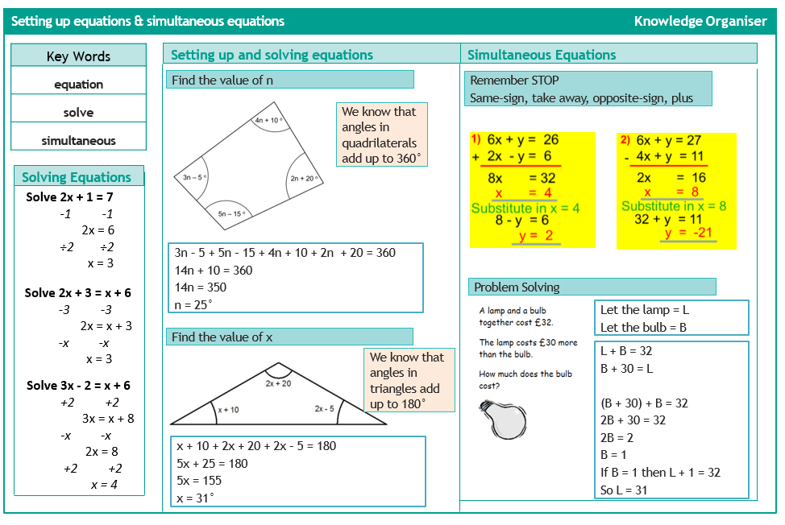
Setting up and solving

Slide 3
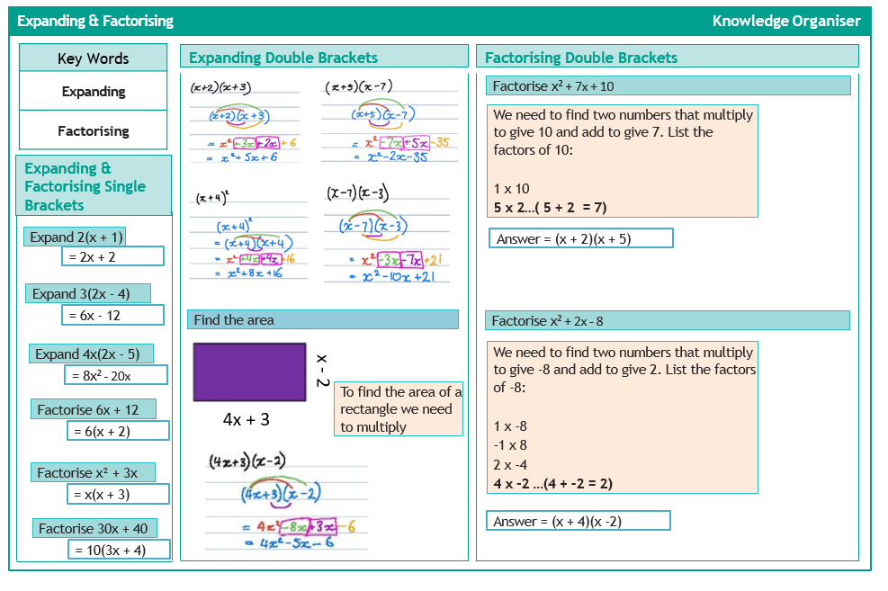
Expanding & Factorising

Slide 4
Ratio

Slide 5
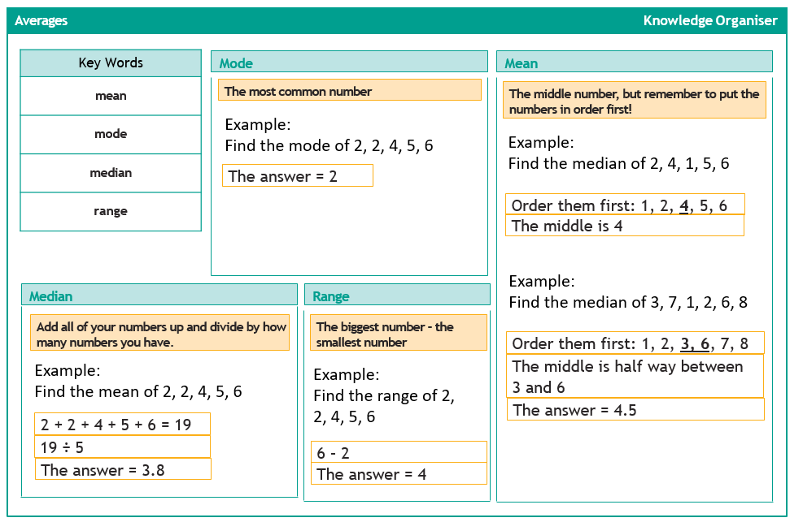
Averages

