Slide 1
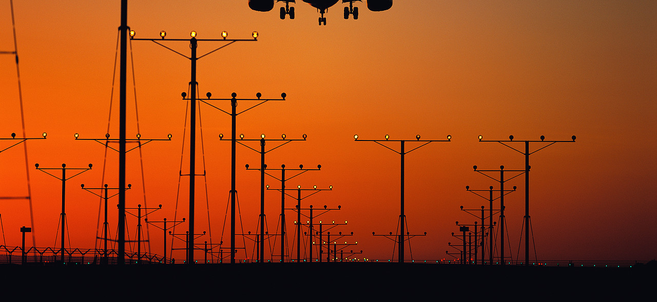
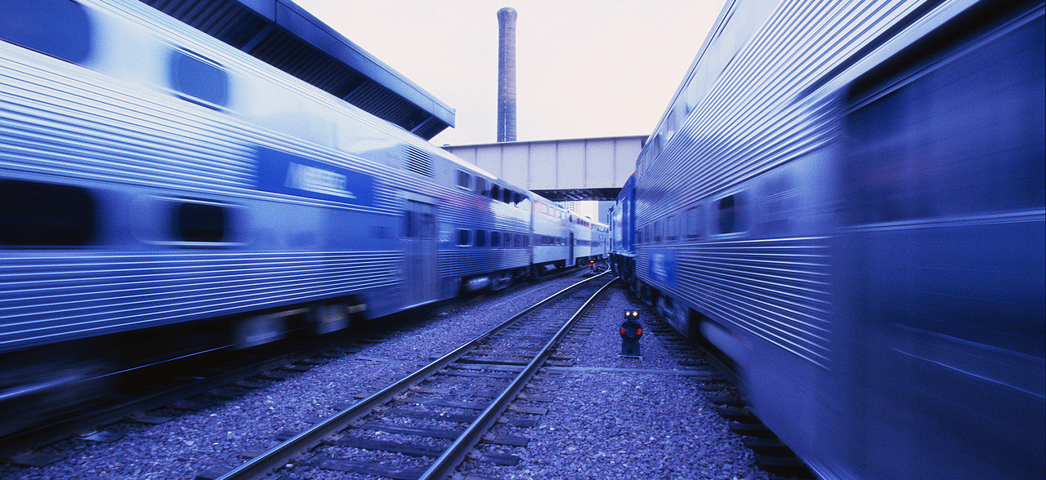
Maths and Transport
Planning the best routes for your company to fly or drive
Detecting when people pose a threat to security on the Tube - CCTV analysis
Designing new technologies to make transport faster and more energy efficient

Slide 2
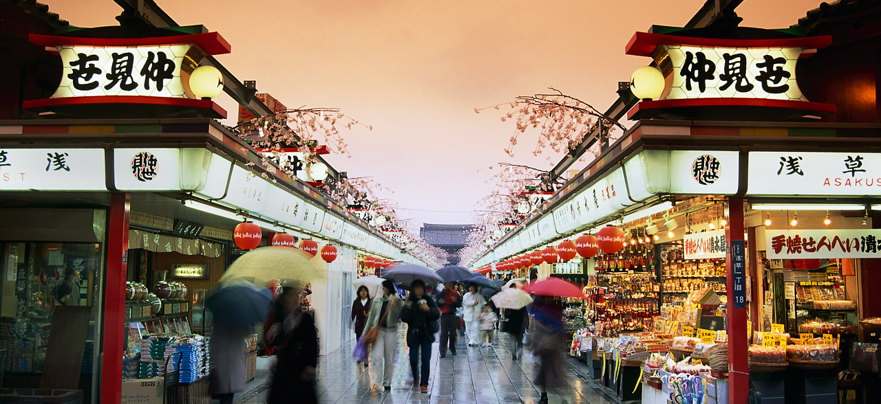
The Travelling Salesman Problem
Given a number of cities and the costs of travelling from any city to any other city, what is the least-cost round-trip route that visits each of the cities?

Slide 3
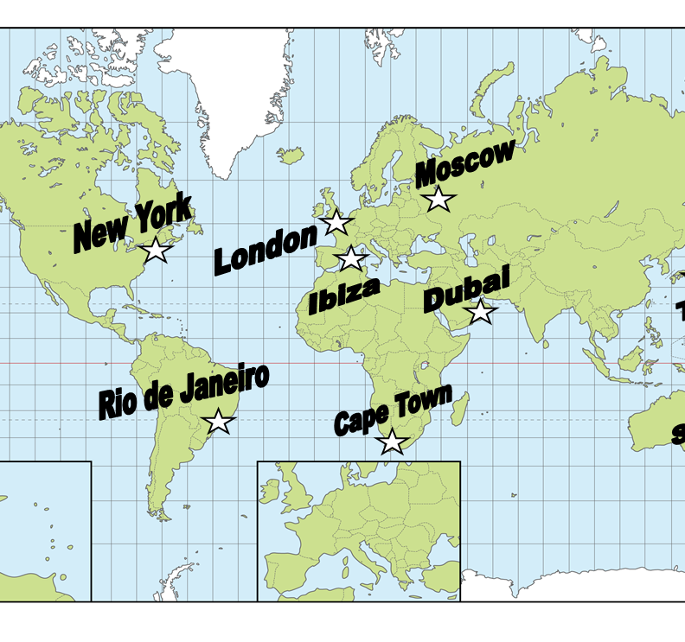
Travel Agent Task
Attempt the task to find the cheapest route between 9 cities.
Use the table provided to plan a route under the cost of £5500!

Slide 4
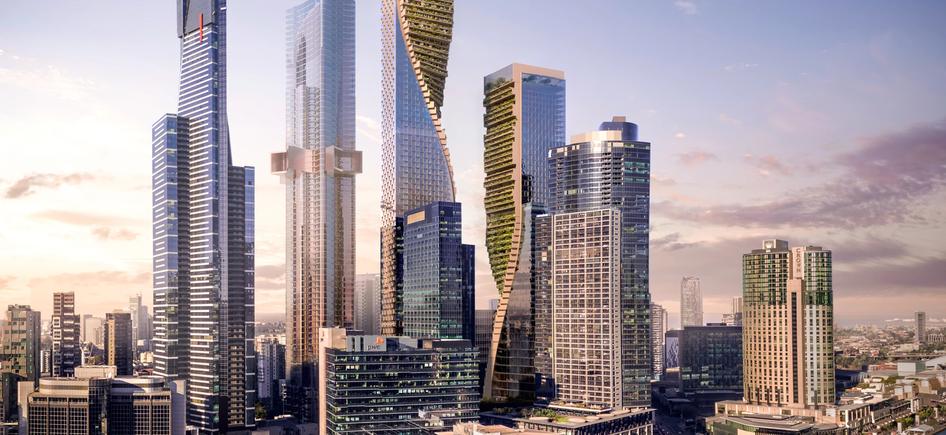
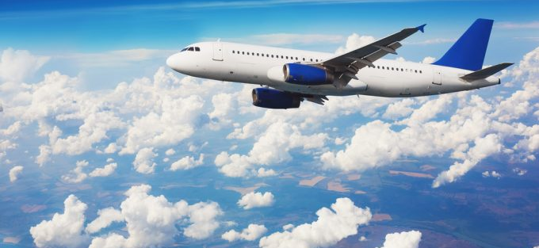
Scaling Up
With these nine cities it’s not too hard to work out some possible cheapest routes.
With 90 cities you’d use a computer, but how long would it take?
For 9 cities, 362 880 possible routes.
For 90 cities
= 90 x 89 x 88 x … x 1
= 1.49 x 10¹³⁸ routes.

Slide 5
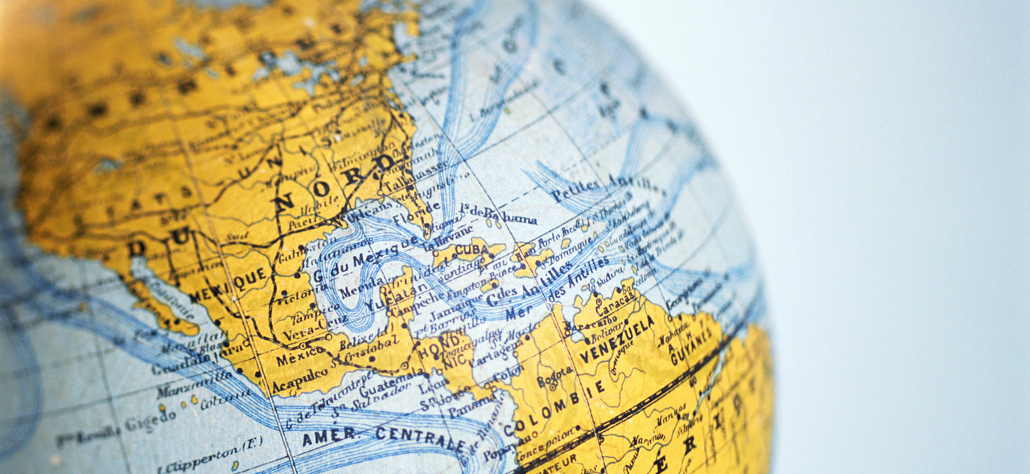
A “Good Enough” Answer
When you were choosing your route, you didn’t have time to check every route.
Instead, you may have tried a route which looked sensible and made small changes to see if they made a cheaper route.

Slide 6
Computer Methods
Modern methods can find solutions for extremely large problems – millions of cities! – within a few minutes.
Such solutions have a high probability of being just two or three percent away from the best solution.

Slide 7
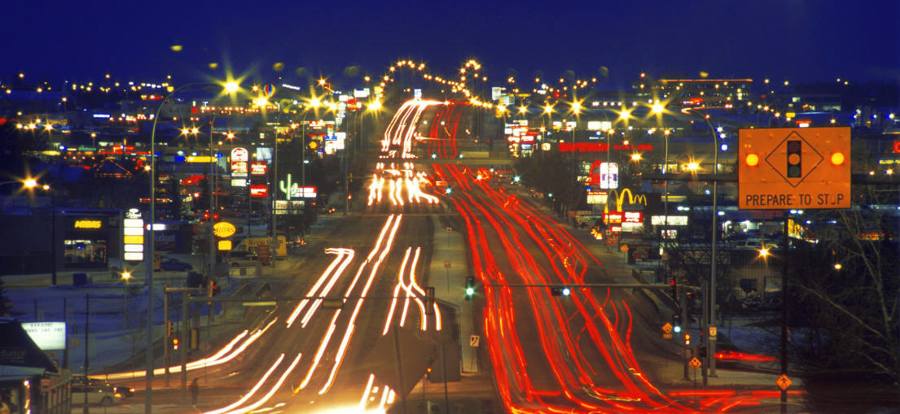
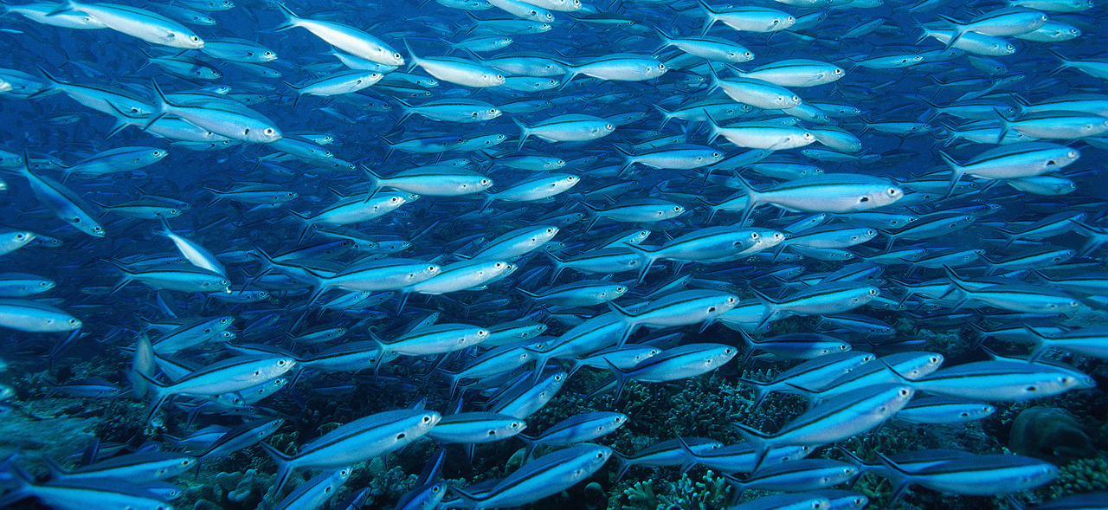
Where’s This Maths Used?
Water distribution
Computer network design
Environmental projects
Design of traffic networks
Music composition
Sudoku puzzle solving
Timetabling software

