Slide 1
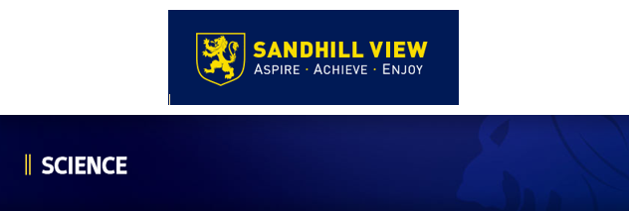
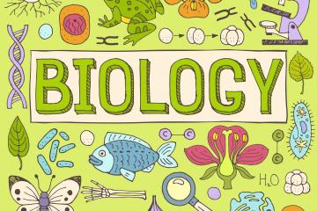
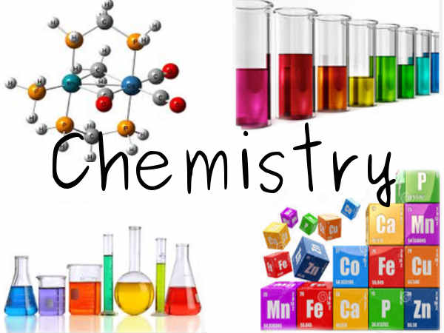
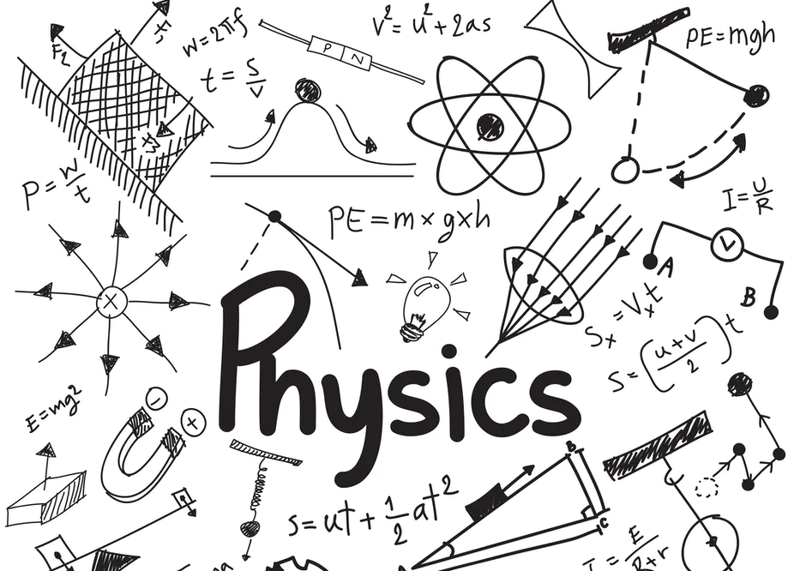
You have two biology tasks, firstly you will be making observations about wildlife – you can do this by going outside or looking out of a window if the weather isn’t good!
Secondly you will be looking into how to stay healthy by looking at the contents of food and drinks as well as measuring your heart rate.
In chemistry your task is to research what happened on your birthday.
Secondly you will be doing a simple investigation into how solids dissolve.
In Physics your task is to make observations of the world around you – including how the moon and Sun change place in the sky,

