Slide 1
Unit 2 - Badminton
Contents
Slide 1 – front cover including name and sport
Slide 2 – The court, dimensions and labels
Slide 3 – Explain the lines for singles and doubles
Slide 4 – Equipment
Slide 5 – How can equipment and the court be adapted to suit younger players?
Slide 6 – Players and roles
Slide 7 – Start of play, scoring system and how to win a game
Slide 8 – Roles and responsibilities of officials

Slide 2
Badminton
The objective of Badminton is to hit the shuttlecock onto the other side of the net, so it hits the floor, you will get a point. However,during a serve if you hit the shuttlecock and it hits the floor, behind the line, YOU lose a point. Two teams take turns hitting the shuttlecock over the net, to try and score points.
Notes:
What is the aim/objective of the game

Slide 3
Rules of Badminton
A match is played with 1-2 players per team.
To score, the shuttlecock must land behind the line and inside of the boundaries.
If you hit the net, or outside of the boundaries, then the opponent is awarded a point.
You are allowed to move once the shuttlecock is in play.
The players body and net are NOT allowed to touch the net.
Players can only hit the shuttlecock once otherwise it’s a fault. Another fault is if the opponent distracts the player.
The referee can call a ‘let’ to pause a play if the player isn’t ready or if an unforeseen accident occurs.
The net must be 1.55 meters tall at the edges and 1.524 meters tall in the middle.
Both feet must be still during a serve. They can move once the racket makes contact with the shuttlecock.
2 Rest periods that last 90 seconds and a 5 minute one after the second game.
Notes:
Rules of Badminton – include 10 general rules
-Size and height of the net
-Equipment – racket and shuttle and how can this be adapted to support younger players?
-Start of play e.g. coin toss and serving
-lines
-Service rules
-Rules of singles and doubles
-Feet rules
- How does a let work?
- Rest periods in the game – when are they and how long do they last
Useful website https://www.rulesofsport.com/sports/badminton.html
https://prezi.com/ksyy5nzmayxm/p2-football-badminton-rules-regs-scenarios/

Slide 4
Singles
In badminton, a match is played best 2 of 3 games, with each game played up to 21 points, so you must win 2 of the games that you play in order to win. However, if the score is 20-20, you must score 2 points to win. In singles, the server must serve the shuttlecock from their right hand side if the score is either 0, or an even number, whereas they stand on their left the score is an odd number. For example, player A is winning 2-1 and is serving next, so he needs to serve from the left diagonally, since the overall score is an odd number. The service area in singles is 24.4m².

Slide 5
Doubles
In doubles, when you serve, you can’t go too long or too short, and you have to have them retrieve your serve. After that, you can hit anywhere in the box. In doubles, you also have to win 2 of 3 games, where the first team to reach 21 points wins that game. The person who wins the last rally will serve next. the serve must travel diagonally over the net into the correct service box. The server must serve the shuttlecock from their right hand side if the total score is either 0, or an even number, whereas they stand on their left if the total score is an odd number.

Slide 6
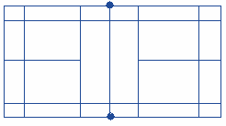
Badminton course
Net Height 1.55m
3.9m
1.98m
0.76m
0.46m
Doubles Service Area
Doubles Rally Area
2.59m
6.1m
Singles Service Area
Singles Rally Area
13.4m
Notes:
Task 1 – add an image of a badminton court
- label the court showing the service and playing areas for singles and doubles
-what do the lines mean?
- add the dimensions
-state the height of the net

Slide 7
Adaption
Badminton can be adapted for younger people by lowering the net. This would allow them to actually be able to hit the shuttlecock over the net, as opposed to into the net. This would allow them to have a fair, balanced game. Equipment could be adapted for younger children, by making the equipment smaller, like rackets, so they can actually be able to hold them, since they might be too big.
Notes:
How can the court be adapted and improved to suit younger players?
- state recommendations e.g. height of the net, increased playing areas, change in service boxes

Slide 8
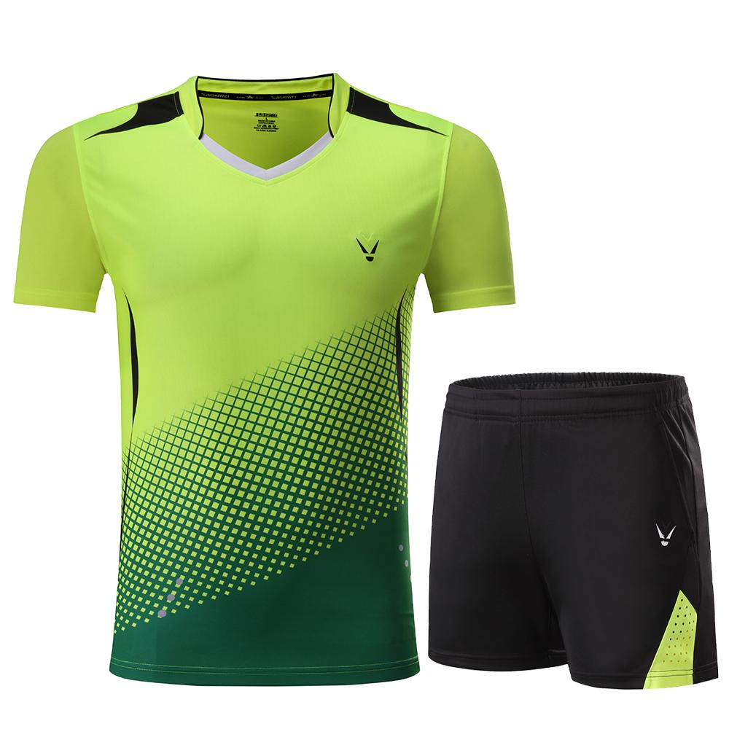
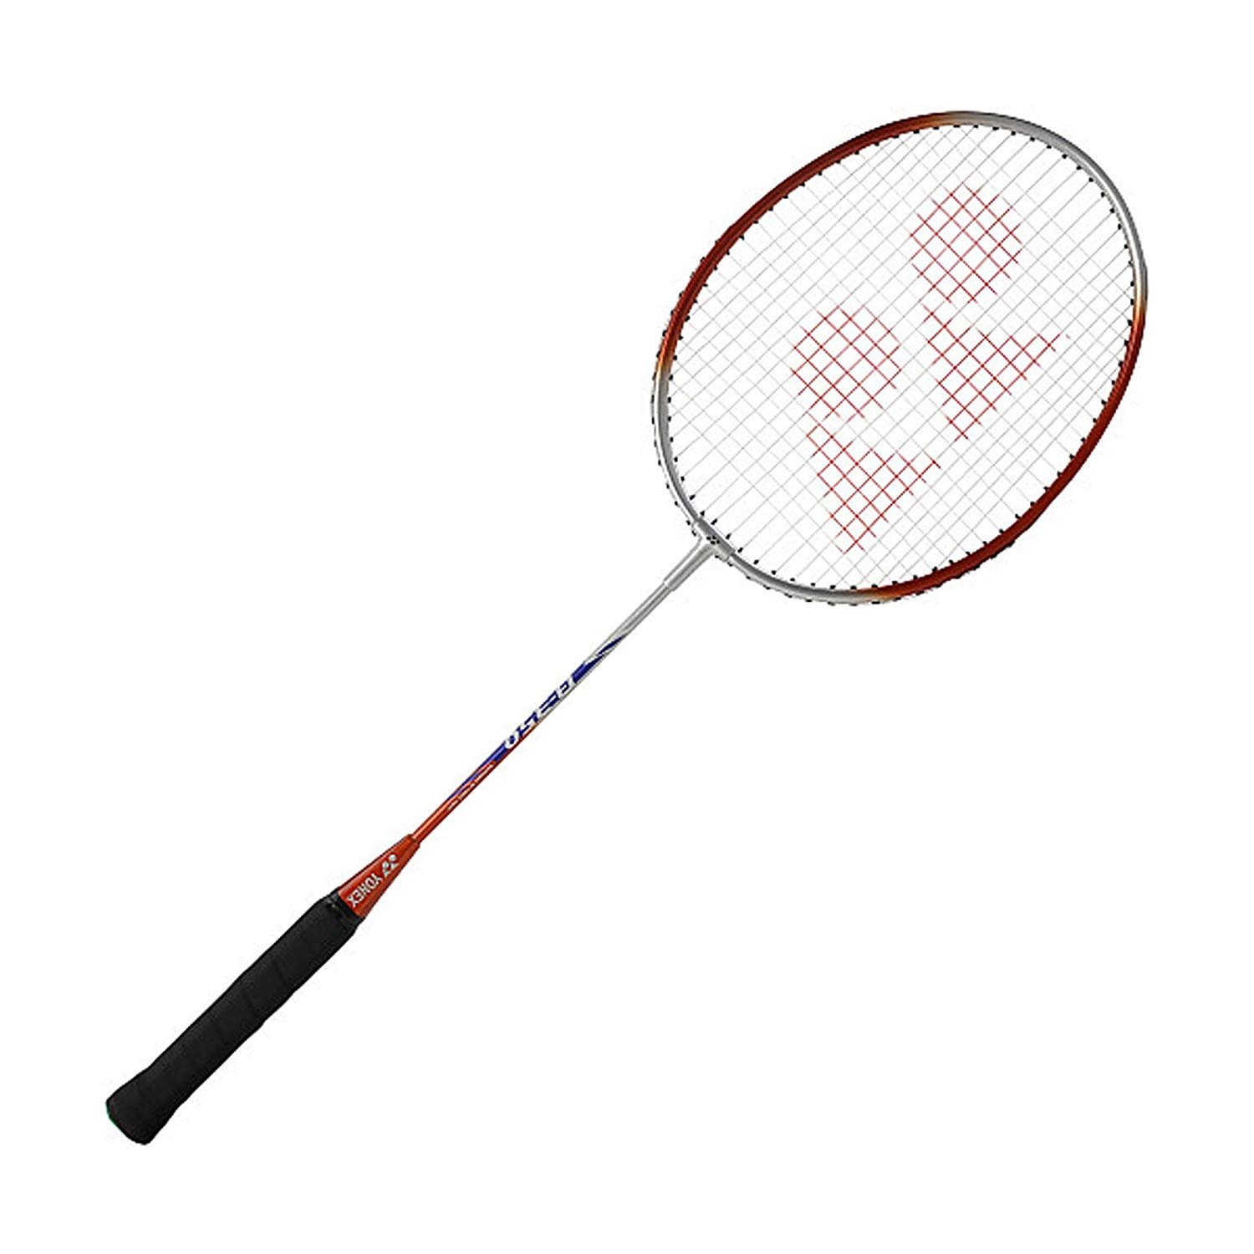
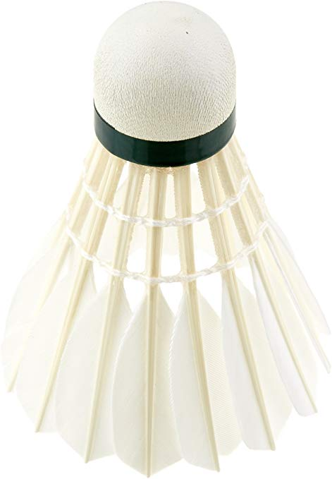
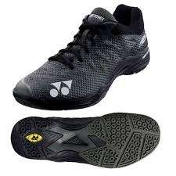
Equipment
Racket
Made so the player can have a good grip on the racket and has surface area big enough to hit a shuttlecock
Badminton clothing
Light clothing, so they can move around faster, reducing drag.
Badminton shoes
These are used to increase traction and stability, so they have sufficient anti-torque protection
Shuttlecock
The object in which you hit with the racket
Notes:
Equipment
Describe and include images of the equipment needed: -Racket
-Shuttle
-Badminton clothing for the players
-Badminton shoes for the players

Slide 9
Scoring System
In badminton, a match is played best 2 of 3 games, with each game played up to 21 points, so you must win 2 of the games that you play in order to win, however if the score is 20-20, you must win by 2 points to win or the first player to 30 points will win. A let occurs when no one is sure whether a shuttle was in or out, or whether a shuttle from another court is hit onto your court. When this happens, the rally is replayed without a change of score or serving position, so the game continues. Points can be earned on anyone's service. In singles, the server must serve the shuttlecock from their right hand side if the total score is either 0, or an even number, whereas they stand on their left if the total score is an odd number. In doubles, when you serve, you can’t go too long or too short, and you have to have them retrieve your serve. After that, you can hit anywhere in the box.
Notes:
Scoring system - create a paragraph stating
-How many games make up a match
-How many points are there in a game?
-Can you win a point on anyone's service?
-How many points clear does a player need to be to win and match and how does this work?
-What are the service rules for both singles and doubles – include odds and evens rule e.g. 0,2,4,6,8 and 1,3,5,7
-what is meant by a let?

Slide 10
Badminton Scenarios
Scenario | Outcome
A player serves the shuttlecock overarm. | the opposition would earn a point, since overarm serves are not allowed. The service judge would call “foul” to let the umpire know that it was a foul serve. The opponent would also serve next.
When serving, the shuttlecock lands outside of the service box. | The other team/player gains a point because the shuttle has landed outside the serve area. The serve judge would call ‘foul’ to let the umpire know that it was out. The umpire would the award the point to the opposition.
During a rally, the shuttle is hit twice on the same side by a player. | The other team would be awarded a point, since this is a foul. The umpire would make the decision and award a point to the opposition and they would serve next.
The score is 20-20. | If the score is 20-20, you must win by 2 consecutive points to win The umpire keeps score. The next player to serve would serve from the right as the score is even.

Slide 11
Roles
Referee- A badminton referee will have total governance during any entire tournament or formal event.
Umpire- Their main focus is to keep close monitoring and governance of all sporting activities on the court. Must record and call score after every round, and must announce the servers score first.
Service Judge- Service Judges call service faults in the game and hand out/hold shuttlecocks.
Line Judge- They are responsible for monitoring the service, side lines, and baseline during a match.
They must wear clothes that distinguish them from the players. This means they must wear a single color polo.
Notes:
Roles of the 4 badminton officials
-state what each of their roles are
-what is the dress code and why
-state what their responsibilities are
-state what qualities they require
-state the components of fitness needed to fulfil their role.

Slide 12
Referee
A badminton referee will have total governance during any entire tournament or formal event. They ensure that the players are given the facilities to practise and play in safe environments. The dress code is that they have to wear a single colour polo,usually white. In better tournaments, however, it must be tucked in. Their qualities include excellent organisation skills and they need a good understanding of tournaments and competitions.

Slide 13
Umpire
Their main focus is to keep close monitoring and governance of all sporting activities on the court. Must record and call score after every round, and must announce the servers score first. They ensure that the match follows the laws of badminton, as well as all rules and regulations. They have authority from the beginning to end of the match.

Slide 14
Line judge

Slide 15
Service judge

Slide 16
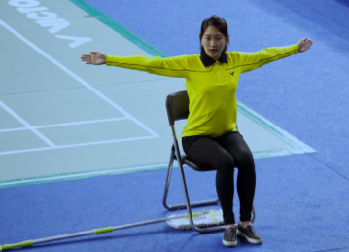
Hand Signals
Line judge will use this sign for an “out” when the shuttle lands outside the court.
Notes:
Hand signals of the officials
-include the names of the officials and the hand signals used within a game (include the image of the hand signal and a description of what it means. Add in a scenario as to what may have happened in the game to show your understanding.

Slide 17
Techniques
Notes:
Techniques needed in Badminton (include the teaching points and an image.
-High serve
Low serve
Overhead clear
Drop shot
Smash
Ready Position – what is it? where is it? Why is it important/
Grip
Shuttle Placement

