Slide 1


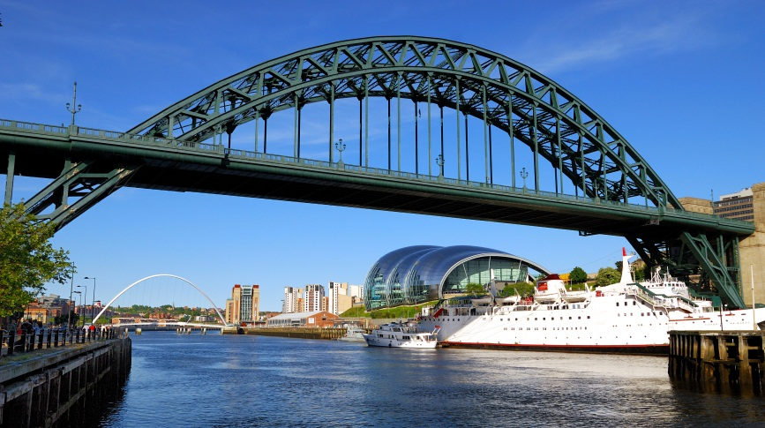
NORTH EAST LABOUR MARKET INFORMATION
Notes:
To give an overview of the current Local labour market.
To explain how understanding LMI can help career planning
To give ideas on how students could do their own research
NEET There are 865,000 young people (aged
16 to 24) in the UK who are NEET. This equates to around 12% of
All, in North East the rate is 16.4% 37000
For the first time in decades, there are more young people in poverty than there are
pensioners in poverty. To solve this we need to work together to prepare our new
generation of young people for work, work is the best route out of poverty.
UK Wide
Business reports that 80% of young people need significant training to be ready for work
49% of SME’s lack digital skills
1.2 million more workers with digital skills will be required by 2024

Slide 2
Key sectors in the North East
Over 80% of our workforce jobs are in services and this is growing.
11% of workforce jobs are in self employment.
Source: ONS Oct 15
Notes:
Services growing particularly information & coms, health, arts & entertainment services.

Slide 3
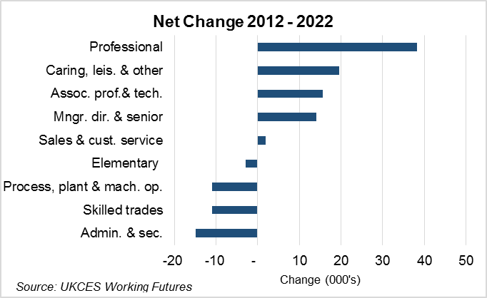
Future Demand
Notes:
Particular groups in professional, technical and managerial type roles plus in caring and other service sector roles
Decline in more traditional roles in trades and administrative roles
But still jobs in these areas

Slide 4
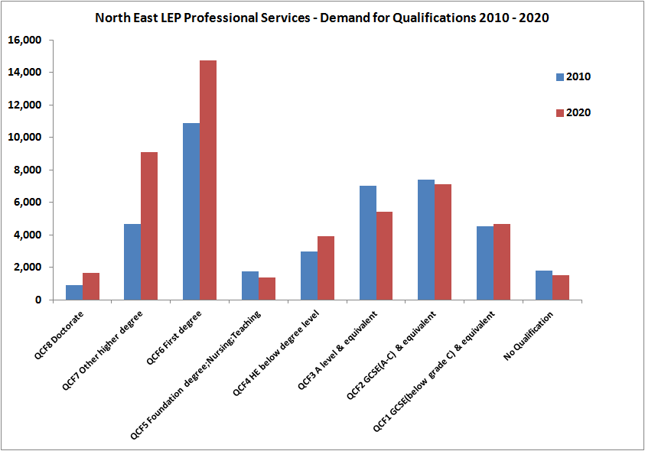
Demand for higher skills
Notes:
Volumes of higher and degree apprenticeships are expected to grow significantly as apprenticeship reforms are embedded, giving students an alternative route to further education.

Slide 5
Future Growth
Passenger Vehicle Manufacturing
Subsea and Offshore Technology
Life Sciences and Healthcare
Creative, Digital, Software and Technology Based Services
Real estate and construction
Financial, professional and business services
Education – in particular, but not exclusively HE
Transport and logistics
Notes:
Sectors predicted to grow

Slide 6

Health and Social Care
NHS – 350+ Roles
Largest North East Employer
5th Largest Global employer
Adult Social Care growing rapidly
Aging work force retiring
Subjects – English, Maths, Biology, ICT, Psychology
Skills/Qualities – Friendly, Caring, Patient, Team Work, ICT, Team Work
Earnings examples – Midwife £35000, Care Worker £16000, Dental Nurse £17500.
Notes:
In the North East we have the highest ranked NHS trust in clinical research studies in the UK
WE are innovating in health and life sciences
Our national centres of excellence are addressing: Ageing and age related diseases, Personalised medicine, national centres in Formulation, healthcare, photonics and dementia

Slide 8

ICT AND DIGITAL
2500 tech related companies in North East
IT and Digital Sectors need more girls! Currently only 23% are females
Sunderland Software City encourages growth of software industry in North East
Subjects - ICT Maths English Physics
Skills/Qualities – Logical, Problem Solver, Communication Skills, Organised
Local Employers – Accenture, Aspire Tech, Sage Group, ITPS
Earnings – IT Tech £28000 Software Developer £40000
Notes:
Our NE software & technology industry is worth £2billion. Our regions specialisms include :
Software development
Cloud computing
System design & communications
Building information modelling
Games design & delivery
There are currently 29000 IT & digital Employees
Coming up
Science City - S&N brewery site £2m cloud computing centre. Sunderland Software City and Coders Academy developing and growing
Big Data revolution will transform our Cities, the North east is shaping up to be a driving force.
New £30 Million National Innovation Centre for Data at Science City Newcastle (NCID) it will offer a hub to act as a production line for talent and innovation. Big data has the potential to add billions to the economy

Slide 9
Engineering and Manufacturing
56000 new Engineering Technicians are needed per year
98000 people in North East work in engineering and manufacturing
Many local companies are small, employing less than 10 people
Subjects – Maths, Physics, Art and Design
Skills/Qualities – Good at Maths & Science, problem solving, manual dexterity, communication
Employers - Nissan, Ford Aerospace, Cummins UK, Unipress
Notes:
Key Growth sectors: Automotive and Medicines
Engineering and advanced manufacturing experienced an additional 8500 jobs up to 2016- North east only region to have a positive trade balance
There are 50,000 STEM students coming through our universities each year.
A new 100 hectare International Advanced Manufacturing Park (IAMP) is to be built in Sunderland, to the west of the A19. This will mean that more large companies will have the facilities and space to set-up and expand in the North East.
The park will be in the region of 100 hectares, providing over 5,200 jobs. There is also the possibility to allow scope for a potential longer term expansion up to 150 hectares if demand requires it. The park will provide modern business premises close to existing employers and would build on the regions advanced manufacturing heritage.
The park will provide a range of building sizes to meet investor requirements. planned and sustainable employment location that maximises links with Nissan and other high value automotive industries. set alongside new infrastructure and services

Slide 10

Construction
3510 new jobs every year
In demand joiners, plumbers, supervisors
Architect earns £38000
Bricklayer £25000
Plumber £28000
Subjects – Maths, English, IT
Qualities/Skills – Good practical skills, follow instructions, head for heights, team work
Employers – Balfour Beattie, Keepmoat, Interserve

Slide 11

Hospitality
People have more leisure time and disposable income
Employers need more people with organisational skills, team work skills, communication skills, customer service
Subjects – English, Maths, Languages, Business Admin
Skills/Qualities Customer service, planning and organising, work under pressure

Slide 12
Other Growth Areas
Science – Science City Newcastle, Medical Research, Ageing research, drug manufacturing – all increasing due to ageing population
Pharmaceutical – Glaxo Smith Kline – Durham, SCM Pharma Northumberland
Tourism – Predicted to be significant employer due to our strengths as a tourist destinations

